Slide 1
Work-case 5
Performed by student
group RPZ-13a
Kateryna Hranat

Slide 2
Mechanism of working with peripheral devices in Linux

Slide 3
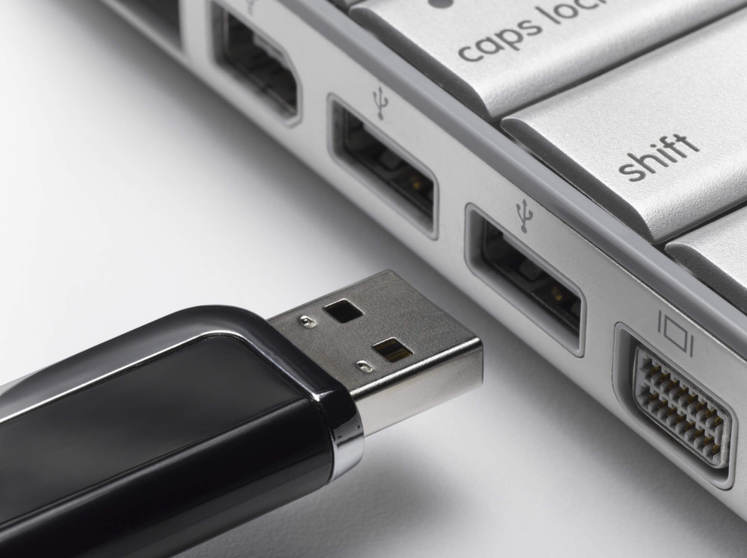
Mounting Operation
The operation of mounting in Linux involves connecting the file system of a device to the OS directory tree, enabling access to the data on that device as if they were regular files. This is done using the `mount` command.

Slide 4
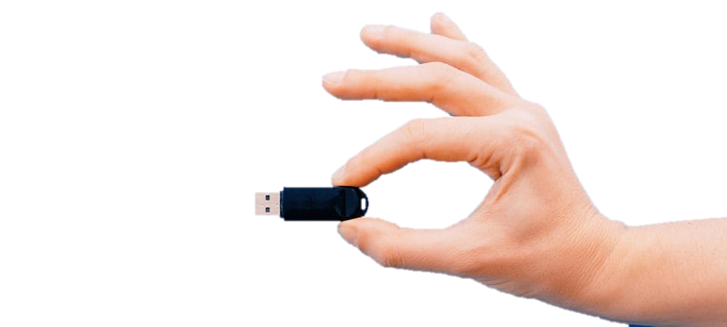
Purpose of Mounting and How it Works
Mounting allows the OS to access external devices such as printers or flash drives by integrating them into the file system. When a device is mounted, its file system becomes accessible to the OS, enabling users to read from or write to it as needed. This process essentially establishes a link between the device and a directory within the file system, allowing seamless interaction with its contents.

Slide 5
Difference in Handling Peripherals between Linux and Windows
In Linux, peripherals are typically accessed through the file system using a mounting mechanism, treating them as if they were files. On the other hand, Windows often relies on device drivers and proprietary software for interacting with peripherals, abstracting away some of the underlying file system operations.

Slide 6
Connecting Peripheral Devices to a Linux Virtual Machine

Slide 7
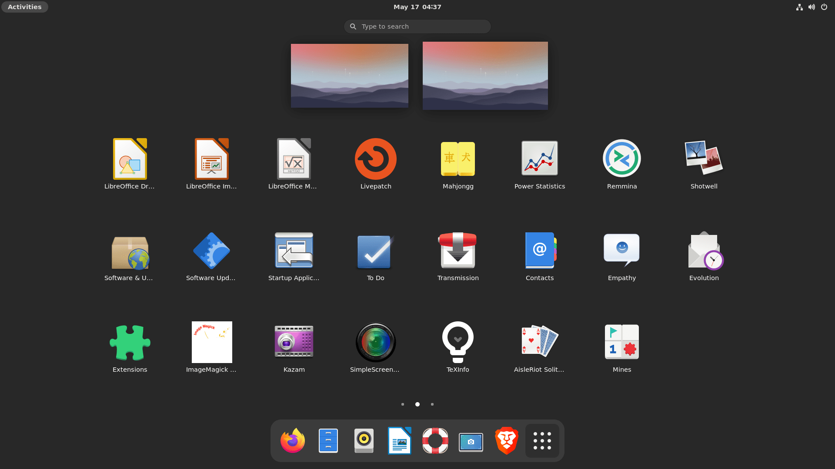
Graphical Interface
If you're using a graphical interface in Linux, such as GNOME or KDE, connecting a USB flash drive or printer is usually straightforward. You can typically plug in the device, and the system will automatically detect and mount it. To copy a file from the flash drive to the virtual machine, you can navigate to the flash drive in the file manager, locate the file, and drag it to the desired location on your virtual machine's file system. To print a file, you can open it and select the print option, ensuring that the printer is correctly configured in the system settings.

Slide 8
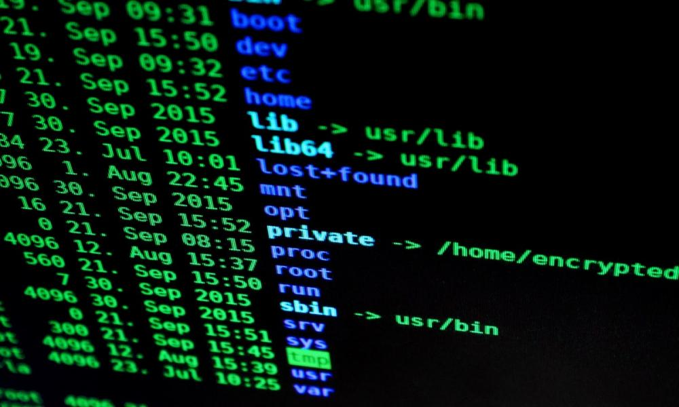
Command Line
To perform the same tasks via the command line, you can use utilities like lsusb to list connected USB devices and lp to interact with printers. To copy a file from the flash drive to the virtual machine, you would first need to mount the flash drive using the mount command, locate the file using ls or cd commands, and then use cp to copy it to the desired location. Similarly, to print a file, you would use the lp command, specifying the file to be printed and any relevant options such as the printer name.

Slide 9

Conclusions:
During the execution of this Work Case, the mechanism of working with peripheral devices in Linux, particularly through the operation of mounting, enables seamless integration of external hardware into the file system. Mounting allows the operating system to treat peripheral devices, such as printers or flash drives, as if they were regular files, facilitating easy access and interaction with their contents. In contrast to Windows, where peripherals are often accessed through proprietary drivers and software, Linux utilizes a more unified approach by integrating peripherals into the file system through mounting. This difference in handling peripherals underscores Linux's emphasis on open standards and modularity. Overall, Linux's mechanism for working with peripheral devices underscores its versatility and adaptability, offering users efficient ways to integrate and utilize external hardware within the operating system environment.
Author – Kateryna Hranat

Slide 10
Thank you for attention!

